Slide 1
Functional Programming Abstractions for Weakly Consistent Systems
KC Sivaramakrishnan
Final Examination
Notes:
Today I am going to talk about how functional programming abstractions can simplify the task of constructing safe and scalable concurrent programs on weakly consistent systems.

Slide 2
Outline
Motivation
Thesis
Contributions
Aneris : A cache-coherent runtime on non-cache-coherent architecture
RxCML : A prescription for safely relaxing synchrony
Quelea : Declarative programming over eventually consistent memory
Conclusions
Notes:
I’ll first introduce the problem and argue why this problem is relevant. Then, I will present my thesis, after which I will present in some detail the three contributions that validate this thesis. Finally, I’ll conclude with a discussion on interesting future work that arises out of the thesis.

Slide 3
~2³ cores
~2⁴ cores
~2⁶ cores
~2⁰ to 2¹⁰⁺ cores
Notes:
We are in an era of pervasive parallelism. Multicore processors have become the norm in mobile, desktop and enterprise computing. Cloud computing has paved way for the developers to rent farms of multicore processors, on a pay per use basis, with the ability to scale on demand.

Slide 4


Memory Consistency Model
Replication,
Coherence,
Asynchrony,
Partial failures,
Heterogeneity,
……
Notes:
While these multicore and cloud compute platforms vary widely, the programmers have an abstract view of these platforms in terms of how the shared memory and computations interact.
In particular, the programmers assume that the concurrent tasks operate over a global shared memory, that is uniformly accessed by all of the cores, with operations from each core interleaved with operations from other cores. Without loss of generality, we assume that the concurrent tasks may interact over shared memory as well as by message passing.
However, the reality is that the shared memory is distributed among the cores, introducing issues such as replication, asynchrony and coherence.
It is the goal of the memory consistency model and associated implementation mechanisms to provide a semblance of programmer’s view of memory.

Slide 5


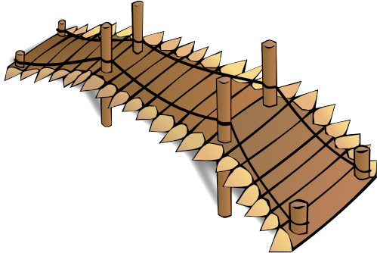
Prog. Model:
Seq. Consist.,
Linearizability,
Serializability, etc.
Data Races
Strong Consistency
Safe and scalable
concurrent program
Impl. Mech:
H/W cache coherence, consensus, atomic broadcast, distributed locks
Atomicity
violations
Deadlocks
Notes:
Concurrent programming models traditionally provided strongly consistent memory, which serves as a bridge between the programmer and his goal to write safe and scalable programs, without falling prey to the typical pitfalls of concurrency such as data races, deadlocks and atomicity violations.
Popular strongly consistent models include sequential consistency, linearizability and serializability.
While the models provide a very high-level simple abstraction, the reality is that they are achieved through complex implementation mechanisms such as hardware cache coherence, consensus, atomic broadcast, etc.

Slide 6

Safe and scalable
concurrent program
Data Races
Expanding
chasm
Strong Consistency
bottleneck!
Impl. Mech:
H/W cache coherence, consensus, atomic broadcast, distributed locks
Atomicity
violations
. . . . . . . . .
Deadlocks
Notes:
The problem is that with increasing scale, the implementation mechanisms become a bottleneck, and it becomes increasingly difficult to achieve good scalability with strong consistency.

Slide 7
Strong Consistency on Multicore
Caches improve memory access latency
Conflict with Multi-processing
Hardware Cache Coherence → Strong consistency
DRF programs are sequentially consistent
Coherence mechanisms have become the bottleneck
Power requirements
Complexity of coherence hardware
Storage requirements of cache meta-data
Heterogeneity : GPUs + FPGAs + Co-processors, etc,.
Notes:
Let us focus on multicore processors first. On modern multicore processors, caches are associated with each core or a group of cores in order to improve the memory access latency. Core operate on cached copies of the data in main memory. However, local caches conflict with multiprocessing; updates applied to a particular core’s cache has to be applied to other cached copies in order to preserve the semblance of strong consistency.
This is achieved by hardware cache coherence mechanism. On modern multicore processors typically ensure that DRF programs are sequentially consistent, and thus preserving the semblance of strong consistency.
However, with increasing scale, the H/W cache coherence mechanism becomes the bottleneck due to power requirements, complexity of implementing and verifying the coherence hardware, area occupied by the coherence hardware on the die, storage requirements of cache meta data, and increasing heterogeneity of modern multicore platforms.

Slide 8

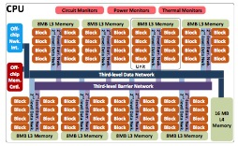
Rise of Non-cache-coherent Hardware
Intel SCC
Xeon Phi
Runnymede
Hardware support
No coherence ←……→ coherence islands
Programmer’s view
No sequential consistency!
MPI, TCP/IP, RDMA, etc,.
Notes:
This has given impetus to the rise of non-cache-coherent hardware such as Intel Single chip cloud computer, Xeon Phi Co processor, and runnymede architecture. On these architectures, cores either have no h/w coherence support or the cores are arranged such that there are islands of coherence between a group of cores and no coherence between the islands. There architectures expose low-level mechanisms such as instructions to control caches in software or dedicated high-bandwidth on-die message passing buffers for intercore communication.
The programmer no longer has strong consistency, and gets to sees that the memory is indeed distributed among the cores, with low-level mechanisms to for inter-core communication. Indeed, these architectures are programmed with low-level libraries such as MPI, TCP/IP or RDMA with release consistency.

Slide 9


Consistency in the Cloud
Distributed stores:
Shared memory abstraction for the cloud
Geo-replication → minimizing latency, tolerate partial failures, availability
CAP Theorem^{[1]} → No highly available, partition tolerant system can provide strong consistency
Live with eventual consistency!
[1] N. Lynch el al., “Brewer's conjecture and the feasibility of consistent, available, partition-tolerant web services”, ACM SIGACT News, 2002.
Notes:
In terms of shared memory abstraction, analogous to non cache coherent hardware is the now ubiquitous geo-distributed stores. Several hosted and non-hosted distributed store are available, and most web-services today are deployed over such distributed stores.
Distributed stores replicate data across multiple sites in order to improve scalability, minimize user-perceived latency, and tolerate partial failures.
CAP theorem states that no distributed system that remains available to user requests and tolerates network partitions can provide strong consistency. Indeed, many web services embrace weaker eventual consistency guarantees so as to provide an always on experience to the user.

Slide 10
Programming under Eventual Consistency
2 distinct concerns
Consistency → when updates become visible
Replica 1
Replica 2
{}
{}
Add(42)
Kyle
Notes:
Programming under eventual consistency is far more difficult than programming under strong consistency. In particular, under eventual consistency, there are two main concerns. First is consistency, which deals with when updates become visible to the user.
Suppose adds an element to a replicated set. The operation typically is applied to a subset of the replicas, and he gets a response.

Slide 11
Programming under Eventual Consistency
2 distinct concerns
Consistency → when updates become visible
Replica 1
Replica 2
{42}
{}
OK
Size()
0
Add(42)
Kyle
Notes:
Later, if kyle requests to count the number of elements in the set, the request may be served by a different replica, the answer might be inconsistent with kyle’s assumptions about strong consistency.

Slide 12
Programming under Eventual Consistency
2 distinct concerns
Consistency → when updates become visible
Add(42)
Replica 1
Replica 2
{42}
{42}
OK
Size()
0
Add(42)
Kyle
Notes:
The update from one replica is eventually merged with all other replicas.

Slide 13
Programming under Eventual Consistency
2 distinct concerns
Consistency → when updates become visible
Convergence → how conflicting updates are resolved
Add(42)
Replica 1
Replica 2
{}
{}
{42}
Rem(42)
Add(42)
OK
Rem(42)
OK
Kyle
Stan
Notes:
The second concern is convergence, that is, how concurrent conflicting updates are resolved. Suppose kyle adds an element, and stan concurrently remove the same element. Their requests may be served by different replicas. Eventually, when the replicas converge, a choice has to be made about the semantics of the final result. Should the new element remain or not. We want to deterministically resolve the conflict on both ends in order to prevent replica divergence.

Slide 14
Programming under Eventual Consistency
2 distinct concerns
Consistency → when updates become visible
Convergence → how conflicting updates are resolved
Add(42)
Replica 1
Replica 2
{???}
{???}
Rem(42)
Inconsistency leaks to the user
Add(42)
OK
Rem(42)
OK
Kyle
Stan
Notes:
Since this problem is dependent on the semantics of the data type, distributed stores typically provide a minimal set of data types with simple conflict resolution such as last writer wins. Such a model makes it onerous for the programmer to coerce the application semantics to the available data types.
Often, inconsistences leak to the user. For example, user may see deleted items in the shopping cart re appearing, and liking a post disappearing.
For this reason, correctness critical applications such as bank accounts are rarely implemented on top of distributed stores, or have external mechanisms to compensate for the consistency bugs.

Slide 15

Relaxed consistency
Latency
Partial failures
Safe and scalable
concurrent program
Data Races
Weak Consistency
Asynchrony
Atomicity
violations
Non-cache-coherence
. . . . . . . . .
Deadlocks
Notes:
To summarize, while weak consistency semantics do allow the programmers to write scalable applications, it is often an error prone endeavor, resulting in unexpected consequences.
As multicore and cloud compute platforms become more ubiquitous, there will be a growing proportion of developers who have to write concurrent programs under weak consistency. It is imperative that we equip the programmers to safely navigate this path.

Slide 16
Key Observation
Add(42)
Replica 1
Replica 2
{???}
{???}
Rem(42)
Add(42)
OK
Rem(42)
OK
Mutation of shared state causes weak consistency issues
Tame shared state mutation → mitigate weak consistency issues
Functional programming
Mutations are rare and explicit!
Notes:
The key observation I make is that the source of consistency problems is the mutation of shared state. While mutation cannot be completely eliminated, by controlling and explicitly reasoning about mutations, we can mitigate the weak consistency issues.
Functional programming languages and abstractions fit this expectation nicely. Under functional programming languages, stress on mutation free programming. And rare mutations when present are explicitly typed.

Slide 17
Thesis
Functional programming abstractions simplify scalable concurrent programming under weak consistency
Cache-coherent, seq. consistent prog. model
Strongly Consistent
CML Semantics
Declarative, extensible, high-level prog. model
Aneris
RxCML
Quelea
Non-cache-coherent Multicore
Asynchronous Distributed System
Off-the-shelf eventually consistent data store
ISMM ‘12, MARC ‘12, JFP ‘14
PADL ‘14
In submission to PLDI ‘15
Notes:
Building upon this observation, my thesis is that functional programming abstractions simplify scalable concurrent programming for weakly consistent systems.
I validate the thesis through three major contributions. First, for non-cache-coherent multicore architectures, I have built Aneris, a concurrent functional programming language and runtime that provides the programmer a cache coherent, sequentially consistent programming model.
Next, for asynchronous distributed system, I have build RxCML, an optimistic concurrency control mechanism for Concurrent ML, that profitably utilizes speculative execution to provide a synchronous first-class channel abstraction that preserves the strongly consistent CML memory model.
Finally, for programming eventually consistent geo-distributed stores, I have built Quelea, a shallow extension of Haskell that provides a declarative programming model for expressing replicated datatypes. Quelea has a novel contract language that can express ad enforce fine-grained application level consistenct properties on top of off-the-shelf distributed stores.

Slide 18
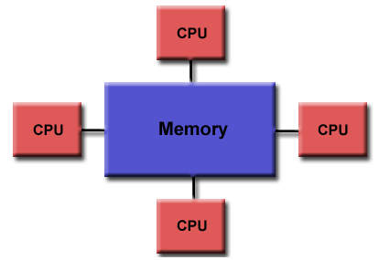
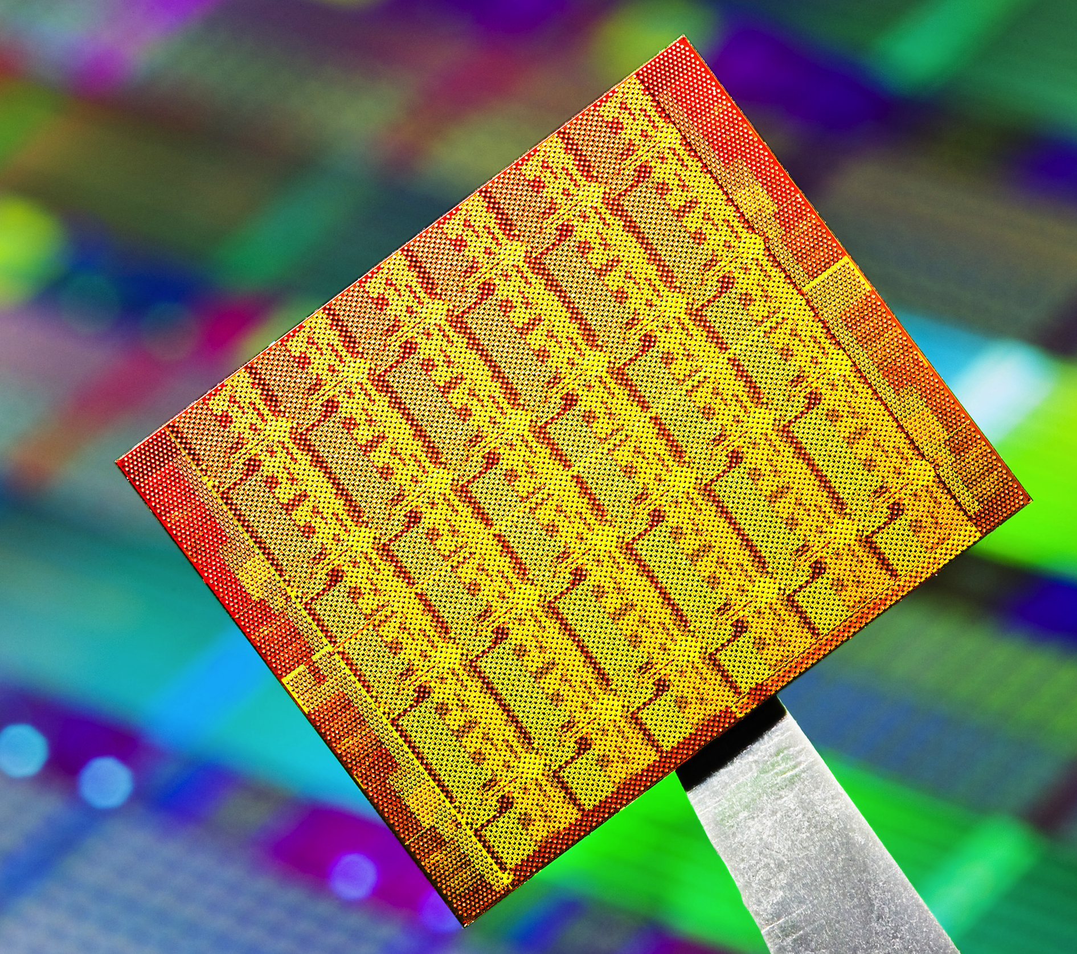

Aneris : Coherent Shared Memory on the Intel SCC
Cache Coherent
Intel SCC
Cluster of Machines
??
No change to programming model
Shared memory
Software Managed Cache-Coherence (SMC)
Distributed programming
RCCE, MPI, TCP/IP
Release consistency + RDMA
Can we program SCC as a cache coherent machine?

Slide 19

Intel SCC: Programmer’s View

Slide 20
Context: MultiMLton on the Intel SCC
Parallel extension of MLton
A whole-program, optimizing Standard ML compiler
Immutability is default, mutations are explicit
Concurrency model – Asynchronous CML
Collectors
LC, PRC, SMC
send (c, v)
C
v ← recv (c)

Slide 21
Local Collector (LC)
Thread-local heap → Circumvent the need for coherence
No access to remote core-private memory → no need for cache coherence
Requires both read and write memory barriers!
Write barrier globalizes; read barrier handles forwarding pointers
Can we eliminate this overhead?
Shared Memory
Uncached Shared Heap
Local Heap
Local Heap
…
Local Heap
Private
Memory
Private
Memory
Private
Memory
Core 0
Core 1
Core 47
Notes:
Our first collector LC utilizes thread-local heap design to circumvent the need for cache coherence.
The key intuition is that if a core cannot access another core’s private memory, which falls outside its coherence domain, then there is no need for cache coherence.
We instantiate local heaps in each of the private memories, and single shared heap in the shared memory. We disable caching in the shared heap since we do not have coherence. We have the invariant that there are no inter-local-heap pointers and no pointers from shared heap to the local heap. These invariants prevent a core from referring to data on a different core’s private memory, hence obviating the need for cache coherence.
However, in order to preserve the invariants we need both write and read barriers. Whenever a local heap object is assigned to a shared heap object, the write barrier globalizes the local heap object and performs the assignment. A read barrier is also required in order to interpret the forwarding pointers introduced due to globalization.
We implemented this design and measured the read barrier overheads. We saw that the read barriers overhead was 15% of the mutator time. A natural question is whether we can eliminate this overhead.

Slide 22
Procrastinating Collector (PRC)
Exploits concurrent functional nature of programming language
SML (Mostly functional) → Mutations are rare
Write barriers << read barriers
ACML → Lots of concurrency
Eliminate read barriers completely
Mutator must never encounter forwarding pointers
(Rare) Write barriers are more expensive
Immutability: Globalize immutable objects by making a copy.
Dynamic shape analysis: for objects completely in minor heap, globalize and perform minor local GC
Procrastinate: Other objects, suspend threads instead of globalization

Slide 23
Software-managed Coherence (SMC)
Mutability information + software coherence support
Integrate cache control instructions into memory barriers
Caching disabled
SMC - Caching enabled
Shared Memory
Uncached Shared Heap
(Mutable Objects)
Cached Shared Heap
(Immutable Objects)
Local Heap
Local Heap
Local Heap
…
Private
Memory
Private
Memory
Private
Memory
Core 0
Core 0
Core 0
Notes:
Combine the ability to discern mutability information of objects with software support for cache coherence.

Slide 24
Results
Speedup
Heap size vs Total time
PRC(SMC) 23%(33%) faster than LC @ 48 cores
99% of the memory accesses in SMC are cacheable!

Slide 25
Aneris : Conclusion
Concurrent FP language and runtime can effectively mask non-cache-coherence
Utilize thread-local heap architecture to circumvent the absence of coherence
Utilize mutability information to optimize for memory/cache hierarchy
Trade concurrency for minimizing GC overheads

Slide 26
RxCML
Composable Synchronous communication
Transactional
memory
Garbage
collection
Abstraction
Domain
Asynchronous distributed system
Shared memory concurrency
Memory management
Synchronous communication =
atomic { data transfer +
synchronization }
synchrony
latency
Notes:
The main idea of the work is that we believe synchronous communication can be an abstraction for programming asynchronous distributed systems just as transaction memory is to shared memory concurrency and garbage collection is to memory management.
A functional programming language combined with synchronous communication provides an attractive model for shared memory concurrency. The synchronous communication abstraction combines data transfer and synchronization into a single atomic unit. However, in a geo-distributed setting, the synchrony is at odds with high latency.

Slide 27
Can we discharge synchronous communications asynchronously and ensure observable equivalence?
Formalize:
Implement:
Distributed Concurrent ML on MultiMLton (Speculative execution)
Notes:
A distributed implementation of Concurrent ML with a speculative execution framework, that discharges synchronous sends asynchronously, detects when this equivalence fails, and repairs failed executions.

Slide 28
Concurrent ML
val spawn : (unit -> unit) -> thread_id
val channel : unit -> ‘a chan
val send : ‘a chan * ‘a -> unit
val recv : ‘a chan -> ‘a
val sendEvt : ‘a chan * ‘a -> unit event
val recvEvt : ‘a chan -> ‘a event
val sync : ‘a event -> ‘a
val never : ‘a event
val alwaysEvt : ‘a -> ‘a event
val wrap : ‘a event -> (‘a -> ‘b) -> ‘b event
val guard : (unit -> ‘a event) -> ‘a event
val choose : ‘a event list -> ‘a event
...
Thread creation
Synchronous message passing
First-class events

Slide 29
T1
T2
T3
A
send(c1,v1)
recv(c2)
send(c2,v3)
f()
B
g()
h()
send(c2,v2)
recv(c1)
recv(c2)
C

Slide 30
T1
T2
T3
C
asend(c1,v1)
recv(c2)
✘
send(c2,v3)
f()
g()
h()
A
B
send(c2,v2)
recv(c1)
recv(c2)
Theorem:
Cyclic dependence ⇒ divergent behavior

Slide 31
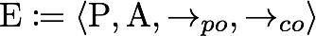
Formalization
Reason axiomatically
Well-formed execution Obs (WF_Exec (P)) ∈ {Obs (Sync_Exec (P))}
Theorem
All Executions
No happens before cycle
Sensible intra-thread semantics
No outstanding speculative actions
Well-formed executions
Sync Executions
Recipe for implementation
Notes:
We reason about our executions, speculative or otherwise, using an axiomatic framework. The axiomatic formalization is similar to the ones used to describe the semantics of shared memory concurrent programs on modern multicore processors. Executions is composed of a set of actions or events that matter, and the relation between the events. A happens before relation, expressed as a transitive closure over the primitive relations, captures the visibility and ordering relation between the events
Our formalization shows that for any execution that satisfies these these properties, there exists a equivalent CML execution. Interpret these properties as a recipe for implementation.

Slide 32
Implementation
Dependence graph ≡ Axiomatic execution
WF check before observable actions
Ill-formed? Rollback and re-execute non-speculatively – Progress!
Channel consistency
Channel state replicas at each site
Preserve CML semantics – Strong consistency!
Recover strong consistency using speculative execution
Mutable references
Cross-site references are prohibited
Checkpoint → local continuation capture + communication log
Notes:
Preserve CML semantics – CML channels are multi-producer, multi-consumer channels. The source and destination of messages are not known a-priori

Slide 33
Results
Benchmark: Optimistic OLTP & P2P Collaborative editing
5.8X faster than sync
1.4X slower than async
@ 48 clients
7.6X faster than sync
2.3X slower than async
@ 6 authors
Rx-CML → efficient abstraction over
high-latency distributed systems!
Notes:
Conclude in this slide. The results demonstrate that Rx-CML can be an effective abstraction for programming high-latency distributed environments.

Slide 34
RxCML : Conclusion
Rx-CML:
Speculative
Execution!
(Performance + Consistency)
Concurrent ML
synchrony
latency
Asynchronous distributed system
+
Strong consistency
of
CML

Slide 35
Quelea
PL support for working with eventually consistent data stores
Problems with existing eventually consistent data stores
Consistency
Basic eventual, session guarantees, timeline, causal, sequential, recency, bounded staleness, etc. + Transaction isolation levels!
Convergence
LWW register, grow-only counter, and a few more.
Lack primitives for operation composition
Goals
Automatically map application-level consistency to store-level consistency
Let the programmer describe their own Replicated Data Types (RDTs)

Slide 36
Quelea: Convergence
RDT specification language
Object state → trace of operation effects
Trace only-grows
No destructive updates → conflicts preserved!
Operations → reduction over trace
Update conflicts are resolved in the operations
Object snapshot
(trace of effects)
Read-only returns Nothing.

Slide 37
Quelea: Consistency
Contract language
Express fine-grained app-level consistency
A contract enforcement system assigns correct consistency level
Describe store semantics in the same contract language
Decidable → Automatically discharged with the help of SMT solver.
Primitive relations
Notes:
Incorporates primitive relations that captures visibility, session order and sameobj relation between the operations.

Slide 38
Bank Account RDT
Goal
deposit, withdraw and getBalance
Balance >= 0
Effects

Slide 39
Bank Account Contracts
Effect of current
operation
Balance >= 0
Any two withdraw operations must be totally ordered
A get balance operation witnessing a withdraw must witness all its visible deposits

Slide 40
Implementation
Support for coordination-free txns

Slide 41
Evaluation: Classification
Operation
Classes
Transaction
Classes
ebay clone
twitter clone
Performance evaluation
Amazon EC2 + Cassandra cluster + Quelea shim layer
Bank account
deposit → EC, withdraw → SC, getBalance → CC
Compared to all operations tagged SC, Quelea had
1DC → 40%(139%) lower(higher) latency(throughput)
2DC → 86%(618%) lower(higher) latency(throughput)

Slide 42
Quelea: Conclusions
PL support for eventual consistency
Convergence
Grow-only trace of effects
Reductions resolve conflicts
Consistency
Contract language for declarative reasoning
SMT solver for contract classification
Realized on top of off-the-shelf stores!

Slide 43
Summary
Functional programming abstractions simplify scalable concurrent programming under weak consistency
Aneris
RxCML
Quelea
Immutability
Eliminating read barriers
Cached shared heap
Mostly functional nature
Small shared heap
Explicit comm.
simplifies formal reasoning
tractable dep. graph
Checkpoint
Save current continuation & ignore heap
No destructive updates
Sequential reasoning for eventually consistent RDTs

Slide 44
Publications
Aneris
JFP 2014 → MultiMLton language and runtime system
ISMM 2012 → Local & Procrastinating collectors
MARC 2012 → Software managed coherence
Best paper award
RxCML
PADL 2014
Quelea
In submission to PLDI 2015

Slide 45


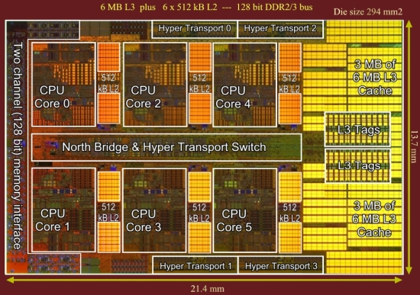
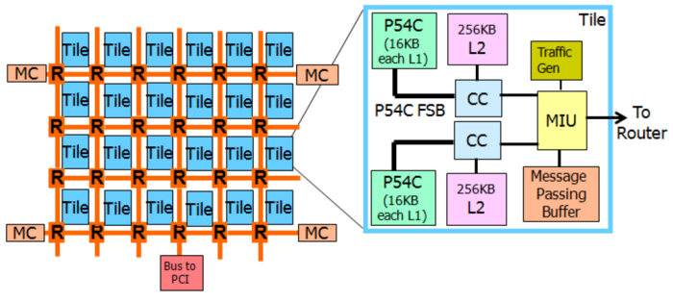
Future Work
SQL
Constraints
Declarative Consistency!
Not NULL,
Unique,
Primary Key,
Foreign Key,
Check,
Default
Contract
Inference
Quelea
Contracts
Quelea
Optimistic
Concurrency
Strong
Consistency
Programming model
Backends
Shared Mem,
Fences, Locks,
Cond Var
Distr. Mem,
SMC, RDMA,
MPB
KV interface,
Vector clocks,
Consensus
Traditional VM
Aneris
Cassandra, Riak, DynamoDB
CC multicore
Non-CC multicore
Geo-distributed
compute cluster

Slide 46
Thank you!

Slide 47

Channel Consistency (1)
Site 1
Site 2
Site 3
send(c1,0);
recv(c1);
{c1:[],c2:[]}
s(c1,0)
{c1:[s(0)],c2:[]}
{c1:[s(0)],c2:[]}
s(c1,0)
{c1:[s(0)],c2:[]}
request_to_match(c1)
{c1:[],c2:[]}
Flush unconsumed
send!
{c1:[],c2:[]}
match (s(c1,0) + r(c1))
Success
{c1:[],c2:[]}
{c1:[],c2:[]}

Slide 48
Channel Consistency (2)
Site 1
Site 2
Site 3
send(c2,1);
recv(c2);
Concurrent
execution!
recv(c2);
{c1:[],c2:[s(1)]}
s(c2,1)
{c1:[],c2:[s(1)]}
s(c2,1)
{c1:[],c2:[s(1)]}
{c1:[],c2:[r2]}
request_to_match(c2)
{c1:[],c2:[]}
request_to_match(c2)
{c1:[],c2:[]}
{c1:[],c2:[r2,r3]}
Lost exactly once semantics
First-come first-match
Success
Mis-speculation!
match (s(c2,1) + r2(c2))
Rollback

Slide 49
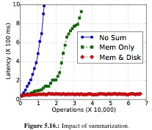
Summarization

Slide 50
Distributed group chat app
No central server & causal dependence
→ causal broadcast
synchronously distribute values
prevent receiver threads from proceeding
Notes:
With purely asynchronous point-to-point communication, one needs to maintain vector clocks and buffering on the receiver side to implement a causal broadcast primitive.
With point-to-point synchronous messaging, causal broadcast primitive can be implemented in a straight-forward manner! Cyclic dependence ⇒ divergent behavior
It is easy to see that this implementation would not scale as phase 2 is a global barrier.
Our idea, take the above synchronous program, discharge the sends asynchronously, detect and remediate causal dependences.

Slide 51
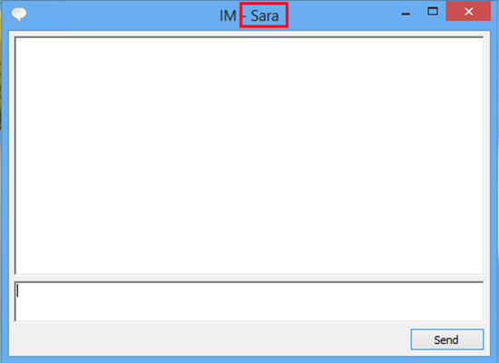

Distributed group chat app
Display thread
show (m)
bsend (m)
IP thread
show (m)
brecv (m)
Listener thread
Notes:
With purely asynchronous point-to-point communication, one needs to maintain vector clocks and buffering on the receiver side to implement a causal broadcast primitive.
With point-to-point synchronous messaging, causal broadcast primitive can be implemented in a straight-forward manner! Cyclic dependence ⇒ divergent behavior
It is easy to see that this implementation would not scale as phase 2 is a global barrier.
Our idea, take the above synchronous program, discharge the sends asynchronously, detect and remediate causal dependences.

Slide 52

Stan
Kyle
Kenny
Display
IP
Listener
Display
IP
Listener
Display
IP
Listener
show (X)
brecv (X)
brecv (Y)
X
show (X)
show (Y)
bsend (X)
X
show (Y)
Y
Presume causal dependence X → Y
Y
bsend (Y)
brecv (X)
show (X)
Causal dependence violated!
X
Cycle Detected!

Slide 53
Distributed group chat app: Performance
US East
EU
US West
Execution | Avg. time (ms) | Errors (per1000 iters)
Sync | 1540 | 0
Execution | Avg. time (ms) | Errors (per1000 iters)
Sync | 1540 | 0
Unsafe Async | 520 | 7
Execution | Avg. time (ms) | Errors (per1000 iters)
Sync | 1540 | 0
Unsafe Async | 520 | 7
Safe Async (Rx-CML) | 533 | 0
Notes:
We simulated the previous example on 3 geo-distributed Amazon EC2 nodes, and repeated the communication patter for 1000 iterations.

Slide 54
Store Contracts

Slide 55
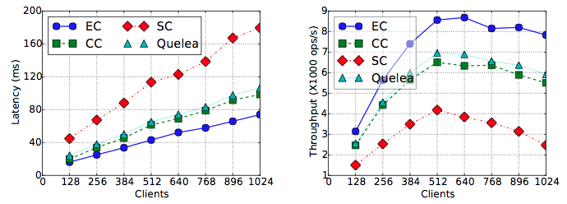
Performance Evaluation: Bank Account
1DC replication, 1024 clients
Quelea had 40%(139%) lower(higher) latency(throughput) than SC
2DC replication, 1024 clients
Quelea had 86%(618%) lower(higher) latency(throughput) than SC

Slide 56

Prelim Milestones (1)
Theory
Static semantics of RDT specification language
Axiomatic Execution
Semantics of RDT specification
Semantics of consistency strengthening operations
Well-formedness definition
Prototype Implementation
RDT specification DSL on top of Haskell
RDT spec compiler that generates
Server-side RDT implementation
Client-side operation library
Prototype data store (over Cloud Haskell)
Objects fully replicated at each replica
Ability to spawn replicas across different availability zones
No fault tolerance (Orthogonal concern)
Trace compression
Request explicit GC operation from the RDT implementor
Implementation of stronger eventual consistency operations
Operational
semantics
+
Coordination-free
transactions!
Full-fledged
Implementation
On Cassandra
Quelea Shim layer

Slide 57
Prelim Milestones (2)
Evaluation
Comparison to Cloud Haskell
Comparison to Self
Benchmarks
YCSB
OLTP
Program Analysis for RDT Specification
Deriving minimal consistency from application-level invariants
Given an invariant over the RDT, what is the minimal consistency annotation required on the RDT operations to preserve the invariant over all executions?
Proving soundness of analysis
Cassandra!
Quelea within
30%(20%) latency(throughput)
RuBIS auction benchmark, Shopping Cart
Twissandra (twitter clone)
Bank account, Concurrent shopping list …
Contracts
Analysis through Z3 SMT solver
Soundness proof

